Slide 1
Analysis of customer satisfaction in airlines
Rushil Anand
Jack Dunn
Arpit Sharma
Vedika Shenoy
Sayali Suryawanshi
Latika Wadhwa

Slide 2
Introduction

Slide 3
What we had
Survey of customers flying within United States
Approximately 130,000 survey responses
Approximately 25 fields in the survey
Aim of this survey
Predict customers with low satisfaction
Generate Actionable Insight

Slide 4
Business questions
Which of the factors surveyed are likely to affect the overall customer satisfaction?
Do obvious factors like the Airline ticket prices, flight arrival delay or cancellation really affect the overall customer satisfaction?
Are there any generalized trends across all the airlines?
What type of travelers are most satisfied with the airlines?
What type of travelers are least satisfied with the airlines?
What class of travelers are the least satisfied?
Between men and women, who is more satisfied with the airlines?

Slide 5
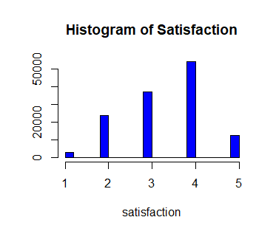
Notes:
We wanted to focus on customers who had a low satisfaction. From this graph, we can see that if we studied the customers with a satisfaction of 1 would be too few . This lead us to define customers who had a satisfaction of 1 or 2 to be considered low. Customers with a satisfaction of 3 or 4 was average and 5 to be high.

Slide 6
OUR APPROACH
READ & CLEAN DATA
No. of attributes in the original dataset: 25
APPLY MODELS TO ANALYZE DATA
Linear model
CREATE ACTIONABLE INSIGHTS
Identified customers with low satisfaction
14 attributes identified relevant to analysis
Associative Rules
Decision Tree
Generated actionable insights

Slide 7
Association Rules
Notes:
Our first model is the association rules.

Slide 8
$$a⇒b$$
𝑎⇒𝑏
Support
Confidence
Notes:
An association rules is an if than statement for a row of data. It basically boils down to something like if a they are a business class traveler then they are dissatisfied. There are two factors that help us determine the usefulness of the association rule. 1) Support. This is how likely the two factors exist in the data together so how many customers had a low satisfaction and were business class travelers. 2) confidence. This is what percentage of business travelers were dissatisfied

Slide 9
Rule | support | confidence
Personal Travel | 0.15 | 0.51
Blue Airline Status | 0.18 | 0.27
Economy Class | 0.17 | 0.21
Flight not Cancelled | 0.20 | 0.20
Personal Travel, Flight not Cancelled | 0.16 | 0.52
Blue Airline Status, Flight not Cancelled | 0.18 | 0.27
Economy Class, Flight not Cancelled | 0.17 | 0.21
Notes:
We ran our algorithms, and these are the rules we came up with. We want a support and confidence to both be large and as close to 1 as possible.

Slide 10
 | support | confidence
Personal Travel | 0.15 | 0.51
Blue Airline Status | 0.18 | 0.27
Economy Class | 0.17 | 0.21
Flight not Cancelled | 0.20 | 0.20
Personal Travel, Flight not Cancelled | 0.16 | 0.52
Blue Airline Status, Flight not Cancelled | 0.18 | 0.27
Economy Class, Flight not Cancelled | 0.17 | 0.21
Notes:
We can see that for our first rule, we have a really high confidence. This means that about half the people who were traveling for personal reasons were dissatisfied.

Slide 11
 | support | confidence
Personal Travel | 0.15 | 0.51
Blue Airline Status | 0.18 | 0.27
Economy Class | 0.17 | 0.21
Flight not Cancelled | 0.20 | 0.20
Personal Travel, Flight not Cancelled | 0.16 | 0.52
Blue Airline Status, Flight not Cancelled | 0.18 | 0.27
Economy Class, Flight not Cancelled | 0.17 | 0.21
Notes:
Looking further into our findings, we can also see that blue airline status and economy class custoemrs were also often unhappy. So it is these three groups of people we should look into.

Slide 12
Low Customer Satisfaction
Personal Travelers
Blue Status
Economy Class
Notes:
This means that this model showed us that the people we should be concerned with are personal travelers, blue status customers and economy class customers

Slide 13
Linear Regression
Notes:
Our next model is the linear regression

Slide 14
How good of a job a variable is at predicting
Which variables are significant at predicting
Linear Regression
Notes:
A linear regression models is an equation

Slide 15
Factors | Adj R-Squared | Factors | Adj R-Squared
Type of Travel, Airline Status, Delay in Arrival Greater than 5 minutes | 0.435 | Type of travel Gender | 0.3385
Type of travel, Class, Airline Status, Flight Cancelled | 0.4089 | Type of Travel Class | 0.3358
Airline Status Type of Travel | 0.4084 | Type of Travel | 0.335
Notes:
Adjusted R-Squared is a method by which we know if a model is accurate or not. The closer to 1 the number is, the better the model. We ran a bunch of models and these were the ones that had the highest R-squared.

Slide 16
Factors | Adj R-Squared | Factors | Adj R-Squared
Type of Travel, Airline Status, Delay in Arrival Greater than 5 minutes | 0.435 | Type of travel Gender | 0.3385
Type of travel, Class, Airline Status, Flight Cancelled | 0.4089 | Type of Travel Class | 0.3358
Airline Status Type of Travel | 0.4084 | Type of Travel | 0.335
Notes:
That means that the values that impact low customer satisfaction the most is type of travel, airline status and whether there was a delay in the flight arrival greater than 5 minutes.

Slide 17
Factors | Adj R-Squared | Factors | Adj R-Squared
Type of Travel, Airline Status, Delay in Arrival Greater than 5 minutes | 0.435 | Type of Travel Gender | 0.3385
Type of travel, Class, Airline Status, Flight Cancelled | 0.4089 | Type of Travel Class | 3.3358
Airline Status Type of Travel | 0.4084 | Type of Travel | 0.335
Notes:
We can also see here that type of travel appears in each model. This means that it has a really high impact on the customer satisfaction

Slide 18
Factors | Adj R-Squared | Factors | Adj R-Squared
Type of Travel, Airline Status, Delay in Arrival Greater than 5 minutes | 0.435 | Type of travel Gender | 0.3385
Type of travel, Class, Airline Status, Flight Cancelled | 0.4089 | Type of Travel Class | 0.3358
Airline Status Type of Travel | 0.4084 | Type of Travel | 0.335
Notes:
We can also see that many of the models have airline status as well Implying it is also important.

Slide 19
Low Customer Satisfaction
Type of Travel
Airline status
Delay of Arrival
Notes:
This all means that we find that for this model, type of traveler, airline status and delay of arrival are the most important factors. Although type of travel and airline status are the most important.

Slide 20
decision tree
Notes:
The last model we used was a decision tree. A decision tree is a way to trace which factors lead to a given outcome. The best way to explain it is to show you one of our models.

Slide 21
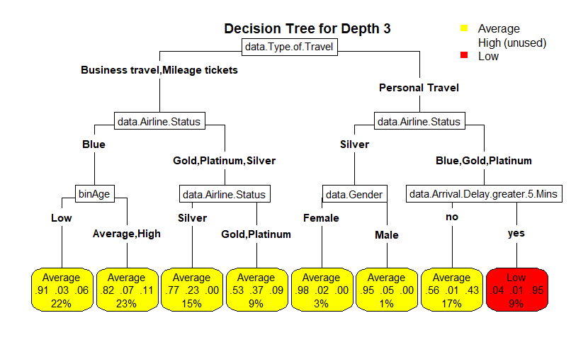
Notes:
We can see here that the algorithm splits the data into groups by how l

Slide 22
Notes:
Here we can see that personal travelers who were blue, gold or platinum level with a delay greater than 5 minutes had the lowest customer satisfaction.

Slide 23
Notes:
However, this was not the most interesting thing we gain from this model. The fact that there was a split between silver and the other statuses is very important information. This means that people who are in the silver program are happier than those who are blue gold or platinum. This definitely requires further research to see what it is about this program that makes customers happier.

Slide 24
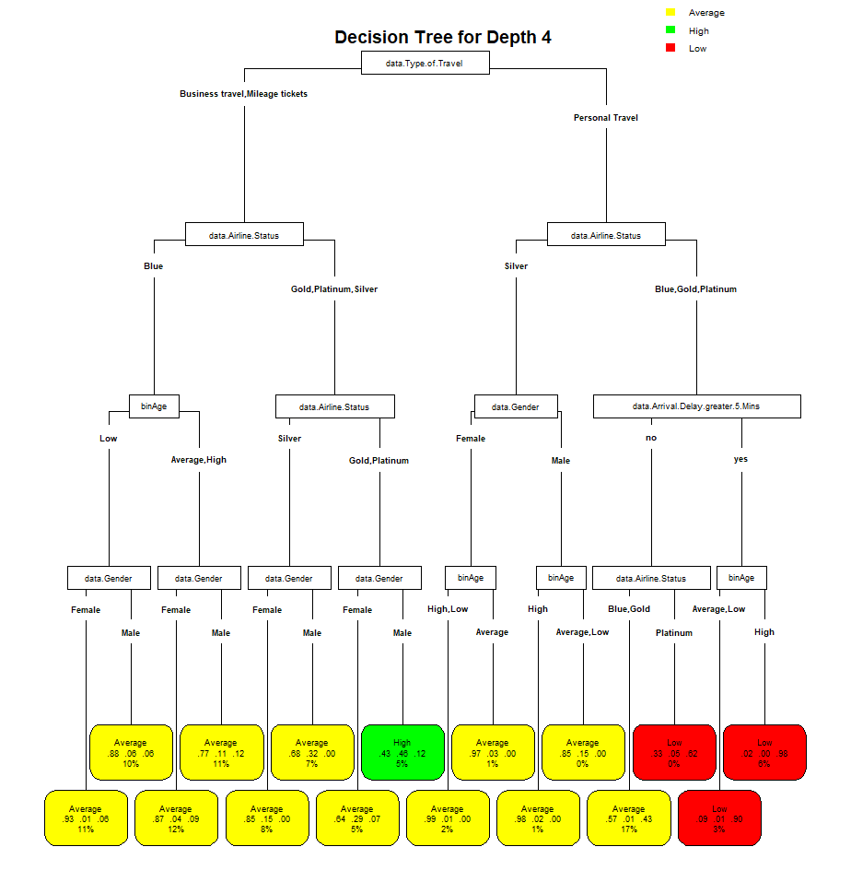
Notes:
We ran another model with four factors effecting satisfaction, we don’t really gain any more information about unhappy customers but

Slide 25
Notes:
But we did find the customers who are the happiest. It is males in the gold or platinum airline status who are business or mileage ticket travelers. These are the travelers who the airline is doing something right with.

Slide 26
Low Customer Satisfaction
Personal Travelers
Not Silver Status
Arrival delay
Notes:
Our findings for this model were that gain personal travelers are the least happy and the silver program in making customers more satisfied and should be looked into further.

Slide 27
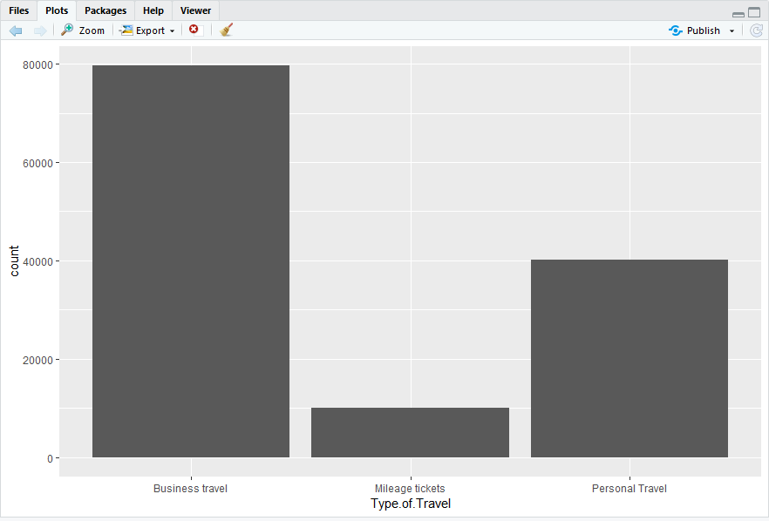
Bar Chart of Type of travel
Notes:
We also see that customers who are in the silver program have a high customer satisfaction for all groups not just personal travelers. This confirms that there is something in the silver program that makes customers happy.

Slide 28
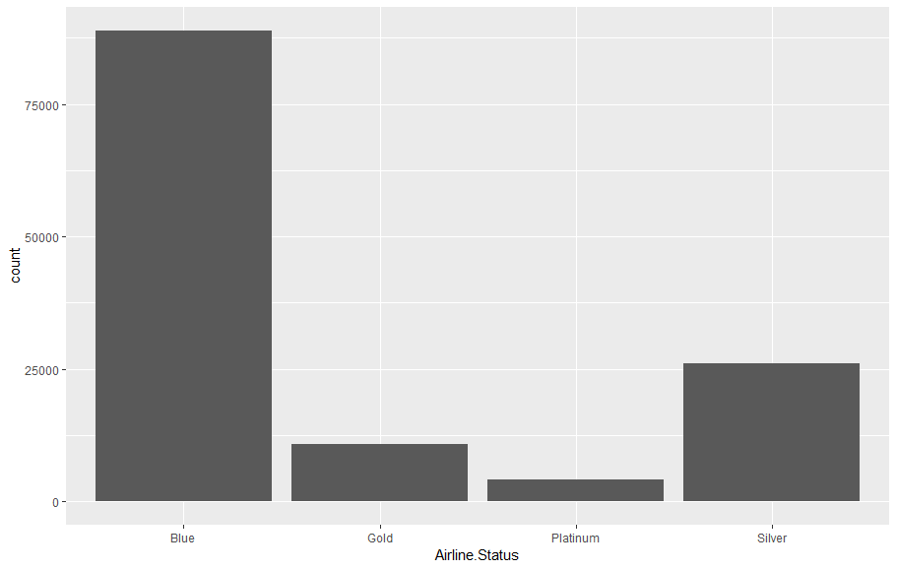
Bar Chart of airline status
Notes:
We also see that customers who are in the silver program have a high customer satisfaction for all groups not just personal travelers. This confirms that there is something in the silver program that makes customers happy.

Slide 29
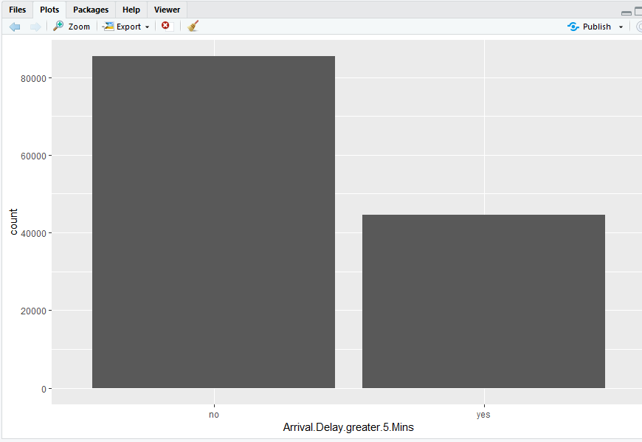
Bar Chart of arrival delay
Notes:
We also see that customers who are in the silver program have a high customer satisfaction for all groups not just personal travelers. This confirms that there is something in the silver program that makes customers happy.

Slide 30
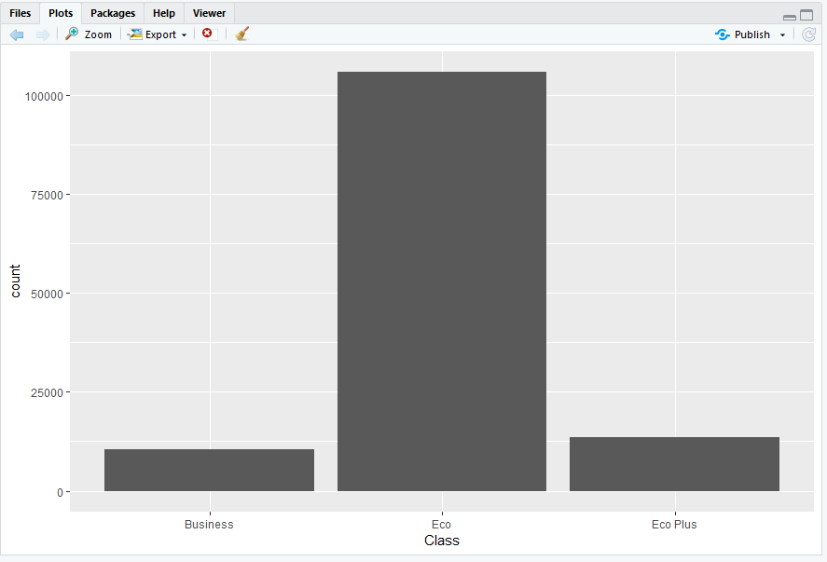
Bar Chart of Class
Notes:
We also see that customers who are in the silver program have a high customer satisfaction for all groups not just personal travelers. This confirms that there is something in the silver program that makes customers happy.

Slide 31
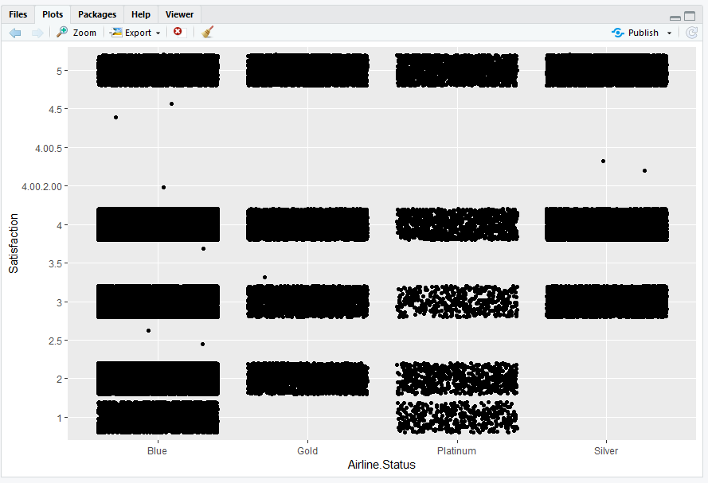
Plot of satisfaction by status
Notes:
We also see that customers who are in the silver program have a high customer satisfaction for all groups not just personal travelers. This confirms that there is something in the silver program that makes customers happy.

Slide 32
Attribute |  | Mean
Type Travel | Business | 3.77
 | Millage | 3.54
 | Personal | 2.55
Delay | > 5min | 3.49
 | < 5 min | 3.17
Gender | male | 3.53
 | female | 3.27
Status | silver | 3.94
 | gold | 3.74
 | platinum | 3.64
 | blue | 3.16
Notes:
We wanted to check and see if our models were accurate, so we simply took the average customer satisfactions of the attributes we found to be important in the other models.

Slide 33
Attribute |  | Mean
Type Travel | Business | 3.77
 | Millage | 3.54
 | Personal | 2.55
Delay | > 5min | 3.49
 | < 5 min | 3.17
Gender | male | 3.53
 | female | 3.27
Status | silver | 3.94
 | gold | 3.74
 | platinum | 3.64
 | blue | 3.16
Notes:
We can see here that personal travelers have the lowest customer satisfaction by a lot thereby confirming our findings.

Slide 34
Attribute |  | Mean
Type Travel | Business | 3.77
 | Millage | 3.54
 | Personal | 2.55
Delay | > 5min | 3.49
 | < 5 min | 3.17
Gender | male | 3.53
 | female | 3.27
Status | silver | 3.94
 | gold | 3.74
 | platinum | 3.64
 | blue | 3.16
Notes:
We also see that customers who are in the silver program have a high customer satisfaction for all groups not just personal travelers. This confirms that there is something in the silver program that makes customers happy.

Slide 35
Attribute |  | Mean
Type Travel | Business | 3.77
 | Millage | 3.54
 | Personal | 2.55
Delay | > 5min | 3.49
 | < 5 min | 3.17
Gender | male | 3.53
 | female | 3.27
Status | silver | 3.94
 | gold | 3.74
 | platinum | 3.64
 | blue | 3.16

Slide 36
Important findings

Slide 37
Important findings
Which of the factors surveyed are likely to affect the overall customer satisfaction?
Type of Travel
Arrival delay
Airline Status
Class

Slide 38
Important findings
Are there any generalized trends across all the airlines?
Type of Travel
Arrival delay
Airline Status
Class

Slide 39
Important findings
Do obvious factors like the Airline ticket prices, flight arrival delay or cancellation really affect the overall customer satisfaction?
Arrival Delay - Yes
Ticket Price – No
Cancellation - Yes

Slide 40
Important findings
What type of travelers are most satisfied with the airlines?
Business Travelers

Slide 41
Important findings
What type of travelers are least satisfied with the airlines?
Personal
Travelers

Slide 42
Important findings
What class of travelers are the least satisfied?
Economy
Class

Slide 43
Important findings
Between men and women, who is more satisfied with the airlines?
Men

Slide 44
Actionable Insights
Personal Travelers
Blue Airline status economy class
Silver status
Better Arrival Times
Notes:
Our primary findings were that personal travelers were the least satisfied. We found that especially those who were in the blue airline status and economy class were often dissatisfied. This lead us to believe that bargain shoppers are the ones we should focus on more than the other customers. Maybe things like coupons and deals might boost these customers satisfactions. We did find that silver status had an unusually high average customer satisfaction. This means that the silver program is a functional program and should be looked at further to see why these customers are happy and perhaps implement some of these program’s perks into other aspects of the airline.

Slide 45

Questions

